Slide 1
Widget Extras
Appendix: Structured Content

Slide 2
Training Overview
Group Workshop
Back-end
Front-end
Services
Integration
Content
Services
Advanced
Security
Widget
Development
Widget Extras
Targeting
Publishing
Container
Development
Foundation
Portal Essentials
Portal Technologies
Portal Tools
Portal APIs

Slide 3
Objectives
Structured Content Types
Structured Content Items
Structured Content Widget
Notes:
The goal of this module is for the trainees to get comfortable with a few things they will be using in their projects.
They need to learn how to use g:include and pipes.
They need to learn how to create ICE templates, and how to add them in the existing ICE widgets. Creating a new ICE widget is out of scope for this training.
They need to learn how to create new chromes, add them in the portal manager, use them for widgets. Also, they need to understand when to use them.
In order to follow the various exercises in this training, you will need to refer to the training material available here:
https://github.com/Backbase/training-fe-module-02

Slide 4
Structured Content
The Basics
Notes:
learn how to create custom content data structure
Structured Content is a feature that offers a lot of control over content through structured templates, yet also offers great flexibility through custom Structured Content types. Developers can create Structured Content types to provide the Structured Content tailored to a specific situation.

Slide 5
Overview
Enterprise Catalog
Struct.
Content
Widget
Struct.
Content
Type
Portal Catalog
Portal Content
Struct.
Content
Widget
Struct.
Content
Type
Struct.
Content
Item
Page
Struct.
Content
Widget
Notes:
https://my.backbase.com/resources/documentation/portal/5.6.0/overview_structuredcontent.html
Explain:
There are three key concepts:
1. Structured Content Type: is a custom catalog item defining the underlying structure of a Structured Content item.
Structured Content types are deployed via Import/Export
2. Structured Content Item: is a content item based on a Structured Content type. Business users can create and update Structured Content items in CXP Manager
From a Content Management perspective, Structured Content items are Reusable Content stored in Content Services, which users can display in the Structured Content widget and manage in the Shared Content and Portal Content apps in CXP Manager.
Structured Content items are deployed via Content Publishing.
3. Structured Content Widget: is a special widget from CXP Universal Collection able to display a Structured Content item.
The Structured Content widget is deployed via Import/Export and, when instantiated on a page, with Page Publishing.
At the Enterprise level, you have the Structured Content Widget and some global Structured Content Types
At the Portal level, widget + types extend from Enterprise
In the Portal, you will create Structured Content items based on pre defined Types, and these items you will use in combination with the SC widget
You can extend the SC widget to add your own custom templates

Slide 6
Overview
Page Instance
Structured
Content
Widget
Portal Catalog
Portal Content
Structured
Content
Widget
Structured
Content
Type
Structured
Content
Item
Server Catalog
Structured
Content
Widget
Structured
Content
Type
Notes:
https://my.backbase.com/resources/documentation/portal/5.6.0/overview_structuredcontent.html

Slide 7
Structured Content Types
To start using Structured Content, you will first need to create a custom Content Type.
Content Types are created using the JSON Schema Standard.
Notes:
Ask if everybody is familiar with JSON schema, if not, point to http://json-schema.org/

Slide 8
JSON Schema Example
{
"$schema": "http://json-schema.org/draft-04/schema#",
"title": "Buying Reason",
"description": "Buying Reason Structured Content.",
"type": "object",
"properties": {
"icon": {
"title": "Icon",
"type": "string",
"metadata": {
"infoText": "Drag on an icon image",
"renderingHint": "image"
}
},
"title": {
"title": "Title",
"type": "string",
"metadata": {
"placeholderText": "Enter the reason title"
}
},
"description": {
"title": "Description",
"type": "string",
"metadata": {
"placeholderText": "Describe the essence of this reason"
}
}
}
}
Notes:
Explain roughly what JSON schema is about
Explain the BACKBASE Specific attribute: metadata
Explain placeholderText
Explain renderingHint
Explain there is also order and infoText
More info: https://my.backbase.com/docs/product-documentation/documentation//portal/5.6.2/structcontent_jsonschema.html

Slide 9
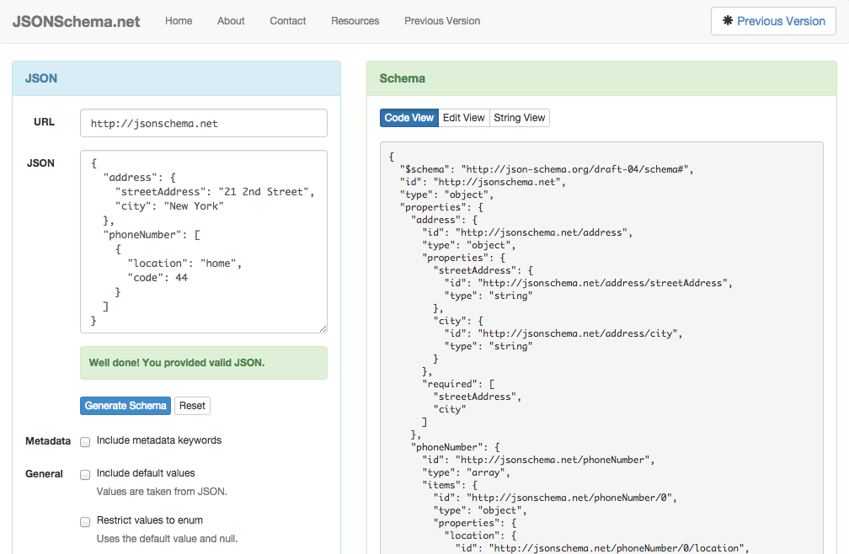
JSONSchema.net
Notes:
Explain that JSONscema.net is a tool that helps you generate a valid json schema based on an expected output
Demo it ?

Slide 10
JSONSchema Demo
Let’s demo how to use jsonschema.net to generate valid content types
Notes:
Use this data structure to demo jsonschema.net
{
"name" : "Visa CC",
"image" : "rel:c44cd676-7e3a-4ba8-a58a-b3b5fcf033c6",
"provider" : "Visa",
"minCreditLevel" : "Excellent credit",
"sellingMotto" : "One time offer!",
"apr" : "15",
"fees" : "0.25%",
"payingInterestTerms" : "1 YEAR",
"buyingReasons" : {
"0" : "rel:46489843-1bab-4e47-bce5-3dfe77ca5af8"
} ,
"conditions" : "Standard Visa conditions"
}

Slide 11
JSON Schema Creation
Follow this how-to guide to learn how to create your first custom Content Type:
https://my.backbase.com/docs/how-to-guides/article//give-your-custom-content-some-backbone-with-json-schema
Notes:
https://my.backbase.com/docs/how-to-guides/article//give-your-custom-content-some-backbone-with-json-schema

Slide 12
Creating Content Items
Once you created a custom Content Type, it’s very easy to create Content Items based on your custom type via the Content Management interface of CXP Manager.
You have the possibility to create Content Items on the server level (so the item can be shared across portals) or for a specific portal.

Slide 13
Content Item Demo
Let’s demo how to create a Credit Card content item based on the custom Content Type we created earlier.
Notes:
At this point , students should have created the CC content type and buying reason content type; uploaded both in their portal
Demo how to access the content management interface, and create a new credit card item

Slide 14
Structured Content Widget
The Structured Content Widget allows you to display content items created via the Content Management interface.
Via the new extension system in CXP 5.6, it is very easy to extend this Structured Content Widget to add your own custom templates.
Notes:
Explain that the SC widget is part of CXP Universal Collection

Slide 15
Structured Content Widget Demo
Let’s see how we can use the Structured Content Widget to display a Credit Card content item.

Slide 16
Exercise: Extending the Structured Content Widget
Follow this how-to guide to learn how to create custom templates and extend the Structured Content Widget
https://my.backbase.com/docs/how-to-guides/article//bring-some-structure-to-your-content
Notes:
https://my.backbase.com/docs/how-to-guides/article//bring-some-structure-to-your-content

